Slide 1


Modification of Flow by Dimples Over a Golf Ball
Submitted By :
HRITHIK S PATIL (231010030)
Vedant Salphale (231010085)
AKSHAT HEMANG JANI ( 231010008)
SUBMITTED TO:
DR. SANJAY MITTAL
DEPARTMENT OF AEROSPACE ENGINEERING
INDIAN INSTITUTE OF TECHNOLOGY, KANPUR

Slide 2

List of Figures
1.1 : Free body diagram
1.2 : Smooth ball projection
1.3 : Comparison of Range
2.1 : CAD Model of the golf ball
2.2 : Meshing
2.3 : Dimple measurements
2.4 : Comparison of Velocity Streamline of Golf Ball and a Sphere
2.5 : Comparison of Pressure Contours of Golf Ball and a Sphere
3.1 : Different dimple configurations
3.2 : Drag and Drag Coefficient
3.3 : Dimple configuration and their effects on distance and height
3.4 : C_{L} vs Velocity curve
3.5 : CL vs Velocity Profiles for Golf Ball C & D
3.6 : Height vs Distance plot
Fig. 3.7 : CL vs S plot
Fig. 3.8 : Different dimple configurations

Slide 3
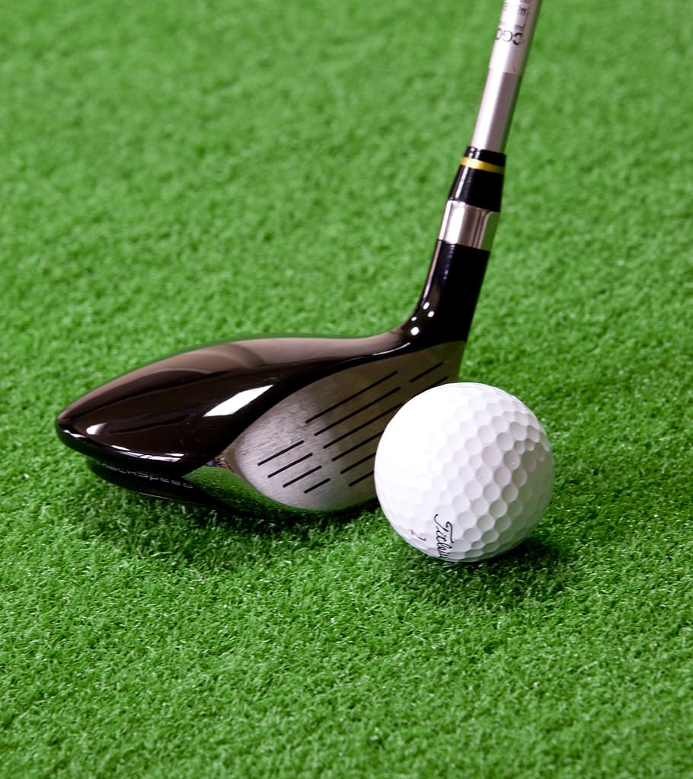
Contents
Equations of motion and trajectories
CFD Analysis of a golf ball and comparison with smooth sphere
Effects of various dimple configuration
Conclusions

Slide 4
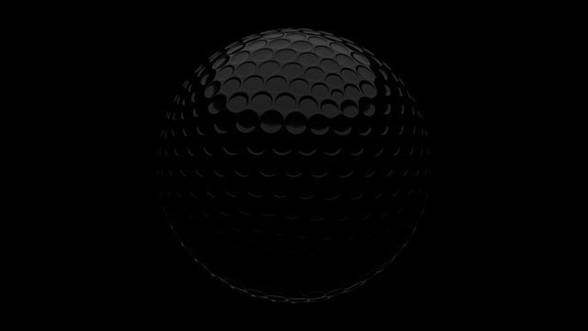
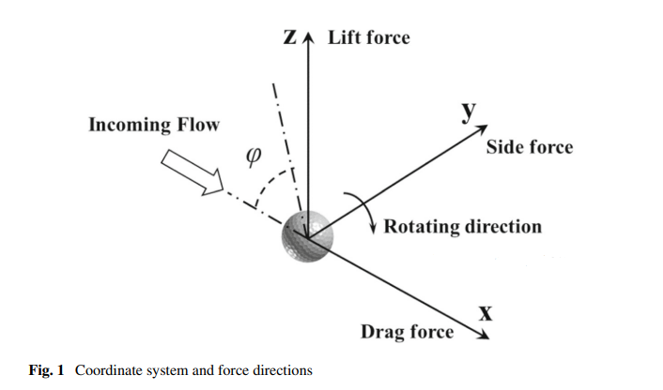
Equations of Motion and Trajectories
Projectile is mainly affected by spin and drag
Classical Model : Only Gravity is the acting force
Smooth Ball
Air molecules in parallel fashion
Laminar Flow
Larger Wake
Decceleration
Fig. 1.1 : Free Body Diagram ^{[1]}

Slide 5
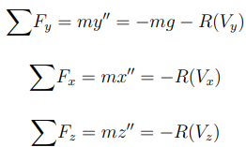
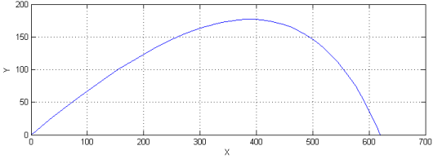
Flight Equations
Fig. 1.2 - Smooth ball projection ^{[2]}

Slide 6
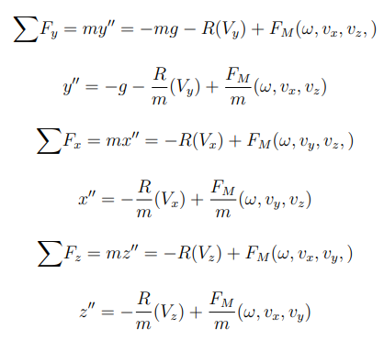
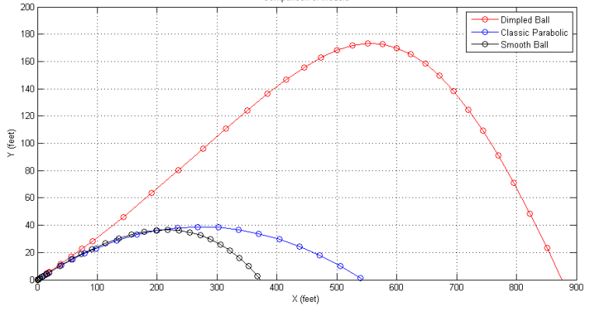
Dimpled Ball
Turbulent Boundary Layer
Smaller Wake
Higher Magnus Force
Air Molecules stay close to surface
Fig. 1.3 : Comparison of range ^{[2]}

Slide 7
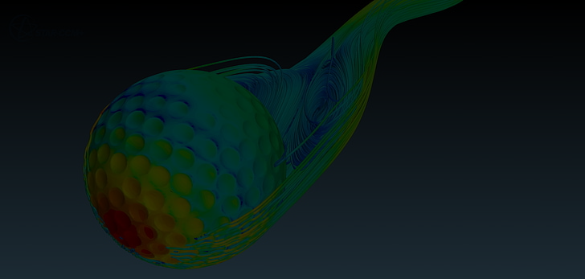
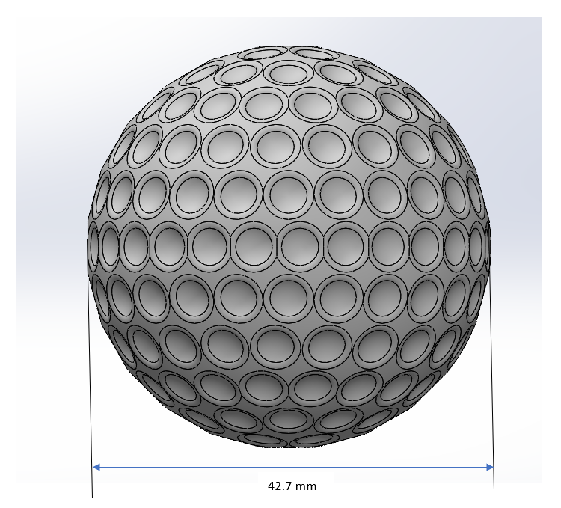
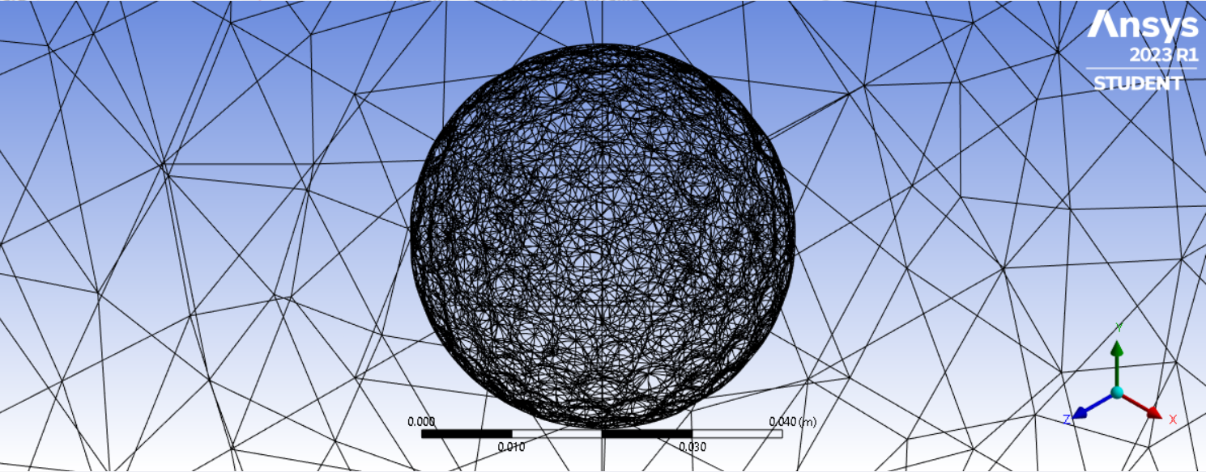
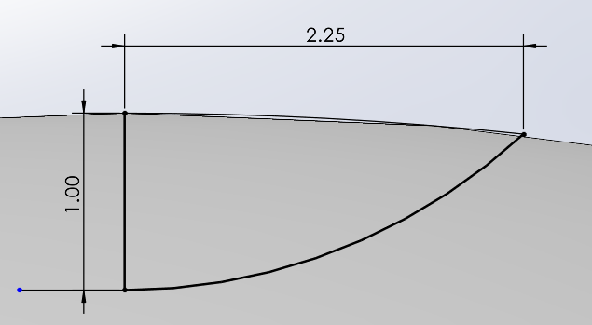
CFD of a Golf Ball
The CAD model was designed in SolidWorks using the features such as REVOLVED BOSS/BASE, REVOLVED CUT, CIRCULAR PATTERNS, MIRROR, etc.
The model was later imported into Ansys Workbench where a Control Volume (Enclosure) of 250*250*250 mm was made followed by Meshing for which details are as follows: Nodes : 417198 ; Elements : 299803
The analysis was further done in Fluent Solver and the velocity streamlines and pressure contours were obtained in Ansys PST
V∞ = 100 m/s, ρ∞ = 1.225 kg/m^3
Fig. 2.1 : CAD model of golf ball
Fig. 2.2 : Meshing Fig. 2.3 : Dimple measurements

Slide 8
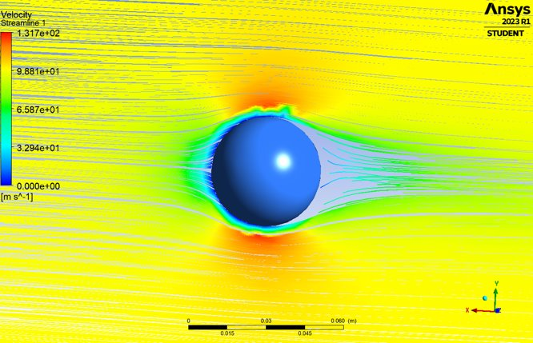
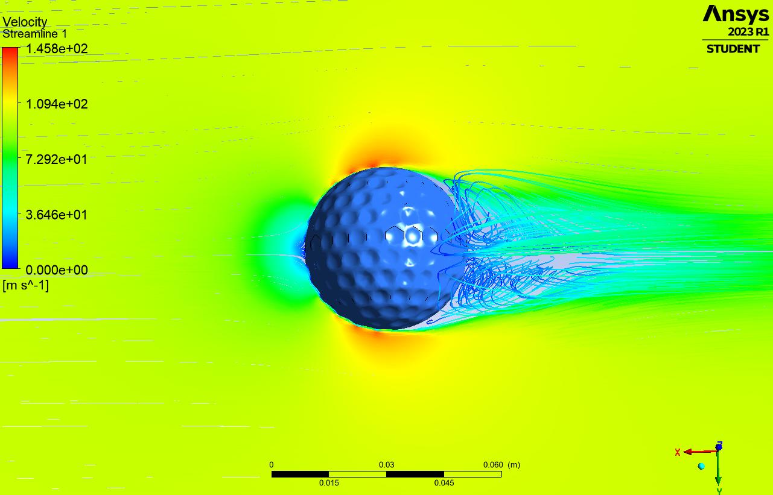
Fig. 2.4 : Comparison of Velocity Streamline of Golf Ball and a Sphere

Slide 9
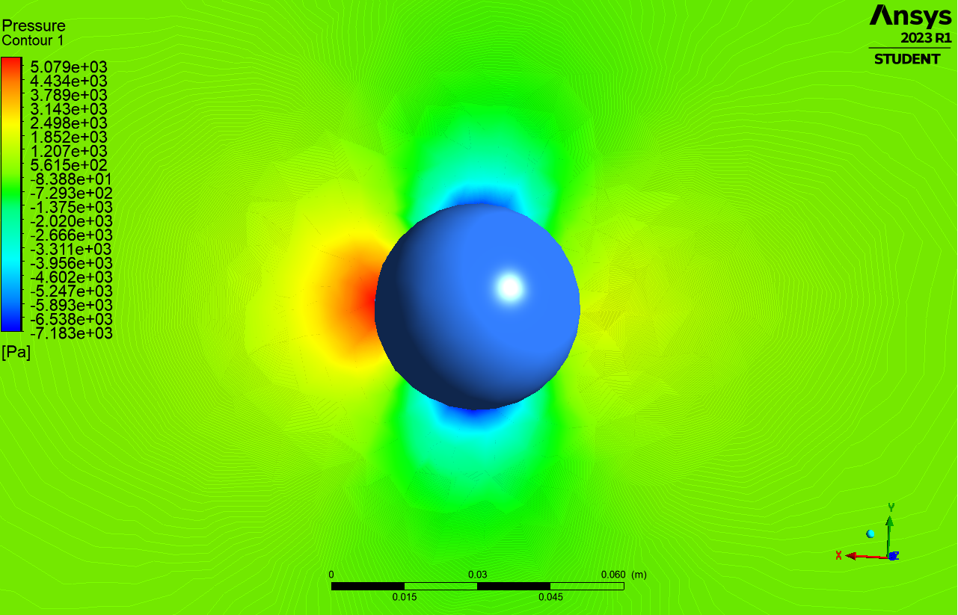
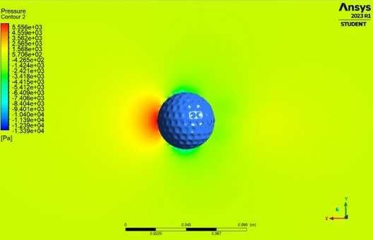
Fig. 2.5: Comparison of Pressure Contours of Golf Ball and a Sphere

Slide 10
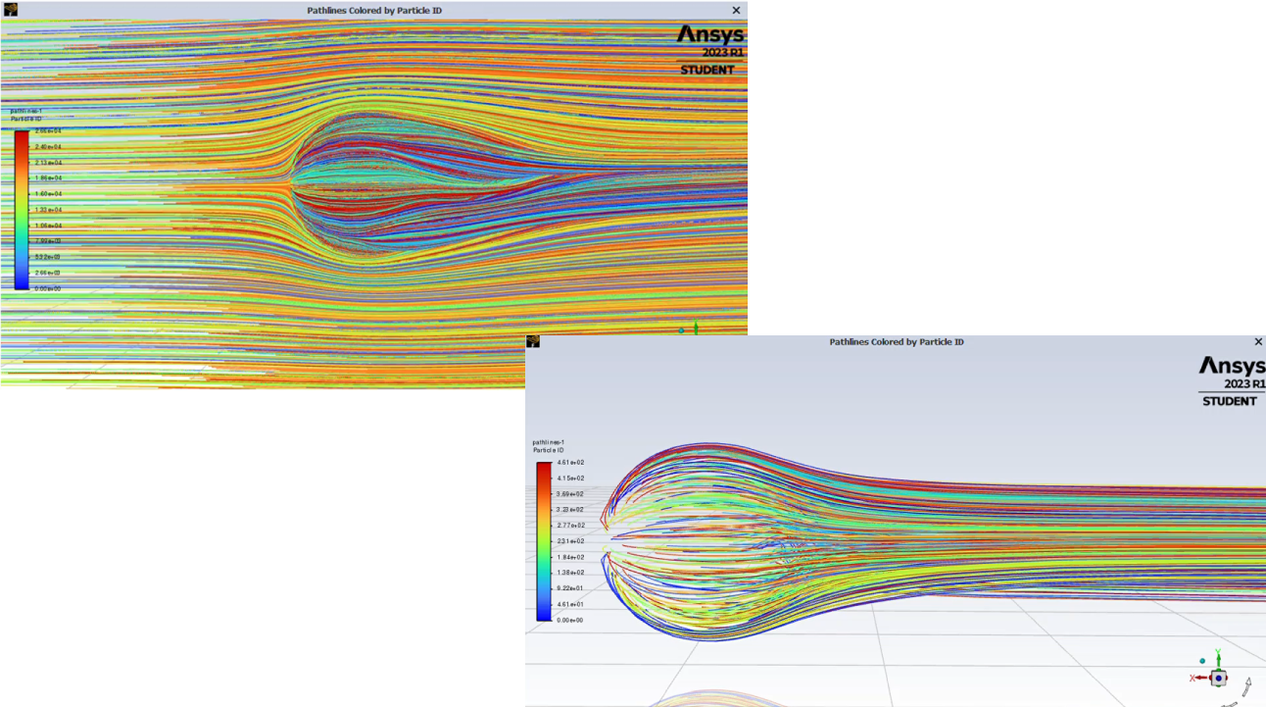

Slide 11

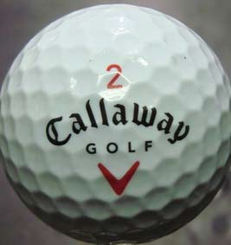
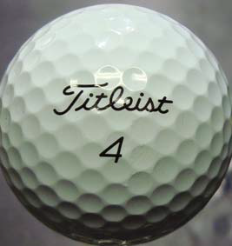
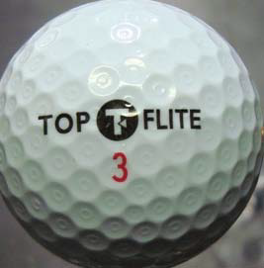
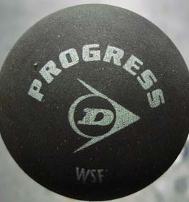
Effect Of Various Dimple Configuration
Callaway Big Bertha
Dimple Shape :
HEXAGONAL
Diameter: 42.67 mm
Mass: 45.2g
2. Titleist Pro V1
Dimple Shape:
CIRCULAR
Diameter: 42.67 mm
Mass: 45.6g
3. Top Flite D2
Dimple Shape:
CIRCULAR WITHIN CIRCULAR
Diameter: 42.67 mm
Mass: 45.5g
4. Squash Ball
NO DIMPLES
Diameter: 40.45
Mass: 24.9g
Fig. 3.1: Different dimple configurations^{[3]}

Slide 12
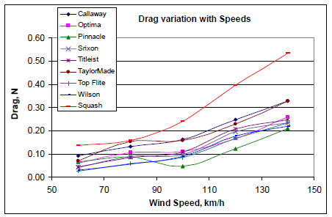
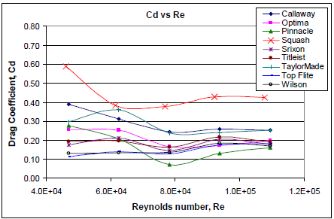
Aerodynamic drag as a function of speeds for all the golf balls
Drag coefficient as a function of Reynolds number for the golf balls
Fig. 3.2 : Drag and Drag Coefficients ^{[4]}
The change from the sub-critical region to the critical region occurs at approximately Re = 1.0×10^5
The average drag coefficient for the golf ball is around 0.2 after the transition

Slide 13
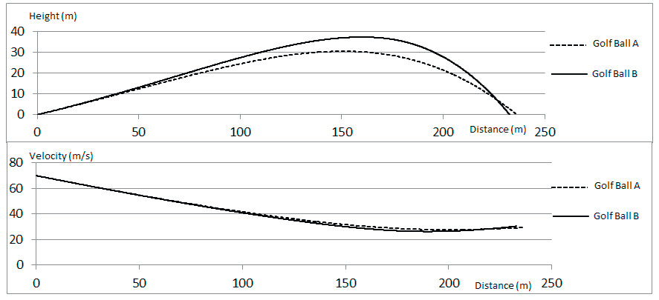
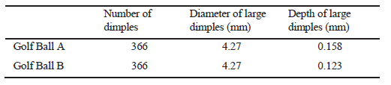
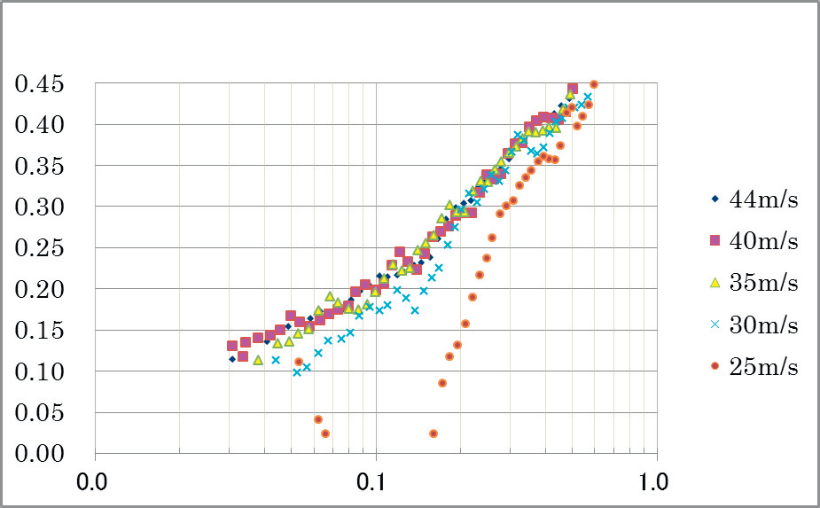
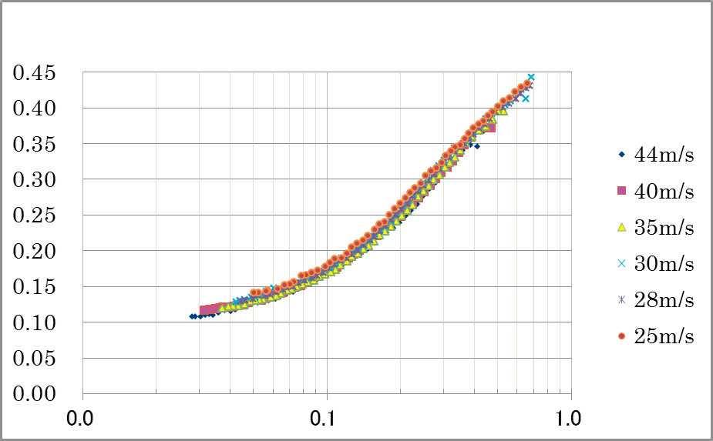
Influence of Dimple Depth on CL
Fig. 3.3 : Dimple configuration and their effects on distance and height ^{[3]}
Golf Ball A
Golf Ball B
Fig. 3.4 : C_{L} vs Spin factor curve^{[3]}

Slide 14
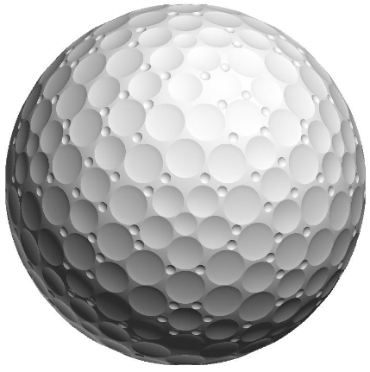
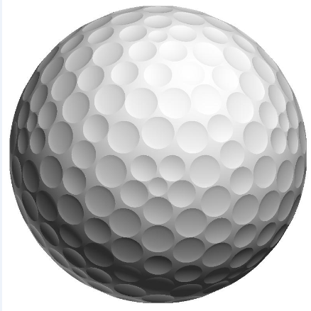
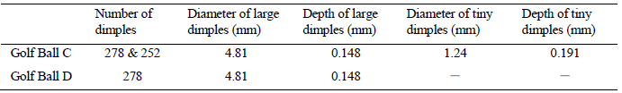
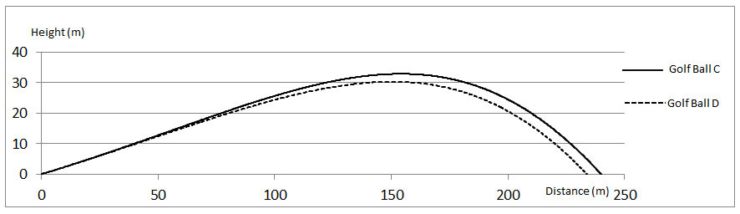
Effect of Tiny Dimples
Golf Ball C
Golf Ball D
Fig. 3.6 : Height vs Distance plot ^{[3]}

Slide 15
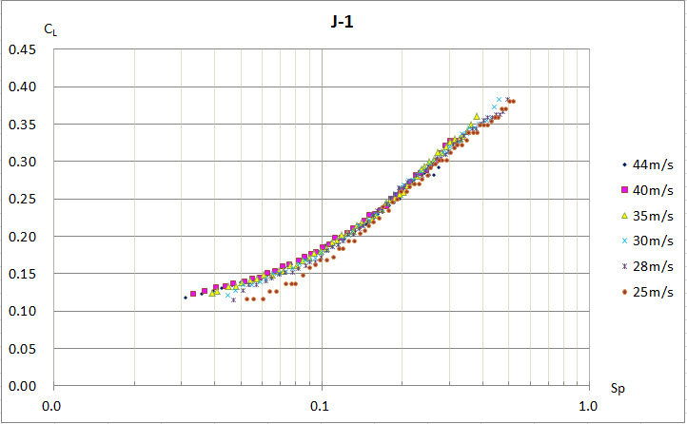
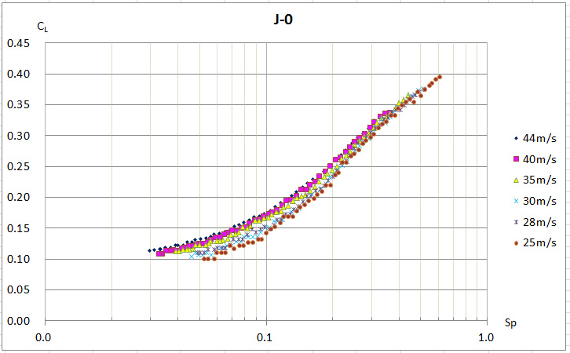
Golf Ball C
Golf Ball D
Fig. 3.5 : CL vs Spin factor for Golf Ball C & D ^{[3]}
It turns out that lift coefficients raise when the depth of dimples is shallow, the number of dimples is lessened, dimples are enlarged, or the share of dimples on all surface is lessened. Also, velocity dependency appears in the low-speed region of 30 m/s or less, and a lift coefficient falls.
In order to avoid the fall of a lift coefficient in a low-velocity range, realizing high lift coefficients on high-speed conditions, tiny dimples are arranged between large dimples.

Slide 16
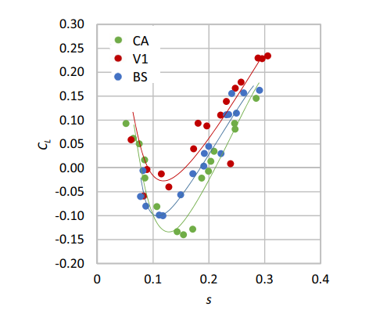
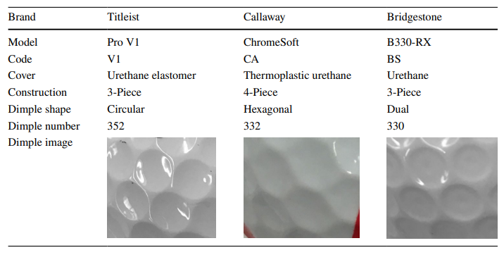
Dimple configuration effect on CL
Due to the different boundary layer flows on the top (laminar) and the bottom (turbulence) surfaces of the balls, the reverse Magnus effect is only observed in the drag crisis region, where the flow on the ball surface transitions from laminar to turbulence.
Fig. 3.7 : C_{L} vs S plot ^{[5]}
Fig. 3.8 : Different dimple configurations ^{[5]}

Slide 17
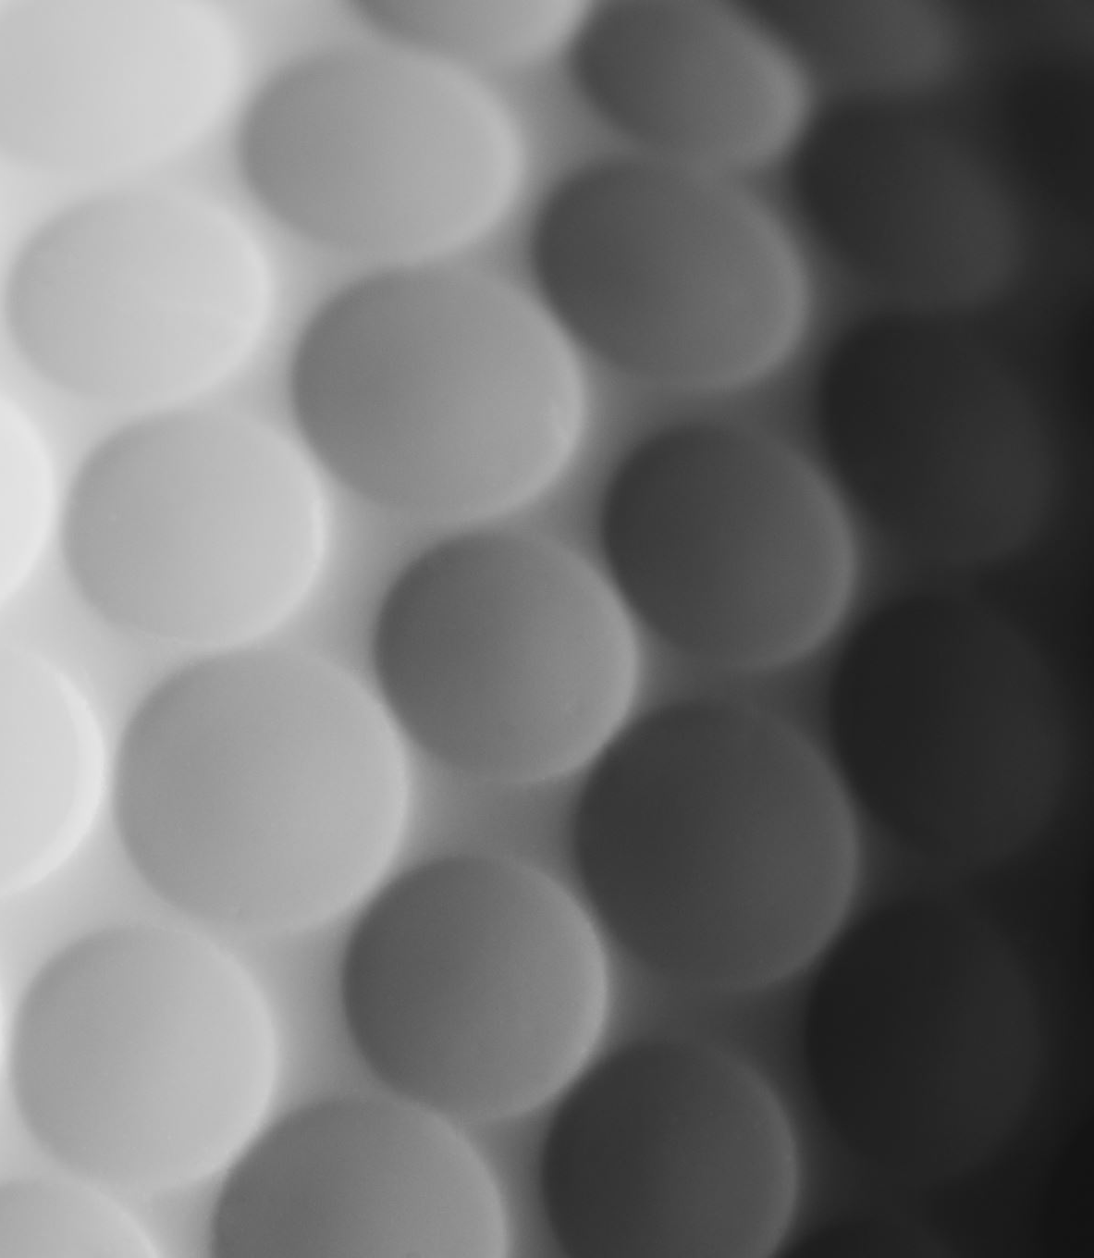
Conclusions
The dimple characteristics have significant effects on aerodynamic properties of the golf ball.
Due to complex dimple geometry, the critical region of a golf ball shifts toward a lower Reynolds number compared to that of a smooth ball. Therefore, the golf ball faces relatively lower drag at low speeds and travels longer distance.
As a result of the wind tunnel experiment results, in a high flow velocity of 35 m/s or more, a golf ball with shallower dimples has a higher lift coefficient. However, when exceeding a threshold, if it becomes too shallow, a lift coefficient will decline greatly at the low speed of less than 30 m/s, and the Reynolds number dependence will appear.
By arranging tiny dimples in the crevices between large dimples, it is able to keep a high lift coefficient.

Slide 18
References
Li, J., Tsubokura, M., & Tsunoda, M. (2017). Numerical Investigation of the Flow Past a Rotating Golf Ball and Its Comparison with a Rotating Smooth Sphere. Flow, Turbulence and Combustion, 99(3–4), 837–864. https://doi.org/10.1007/s10494-017-9859-1
B. Burglund, R. Street , " Golf Ball Flight Dynamics", Union College, 2011
Naruo, T. and Mizota, T. (2014), The influence of golf ball dimples on aerodynamic characteristics, Procedia Engineering, 72, pp. 780–785
Firoz Alam, et al. (2010), An Experimental Study of Golf Ball Aerodynamics, 13th Asian Congress of Fluid Mechanics, pp. 170-173.
Lyu, B., Kensrud, J. R., & Smith, L. (2020). The reverse Magnus effect in golf balls. Sports Engineering, 23(1). https://doi.org/10.1007/s12283-020-0318-1
Crabill, J., Witherden, F. and Jameson, A. (2019), High-order computational fluid dynamics simulations of a spinning golf ball, Sports Engineering, 22(1).

Slide 19
Thank
You

